Slide 1




PHISHING
AWARENESS TRAINING

Slide 2

Table Of Content
Understanding Phishing
Recognizing Phishing Attacks
Avoiding Phishing Traps
Responding to Phishing Incidents
Tips and Practices

Slide 3
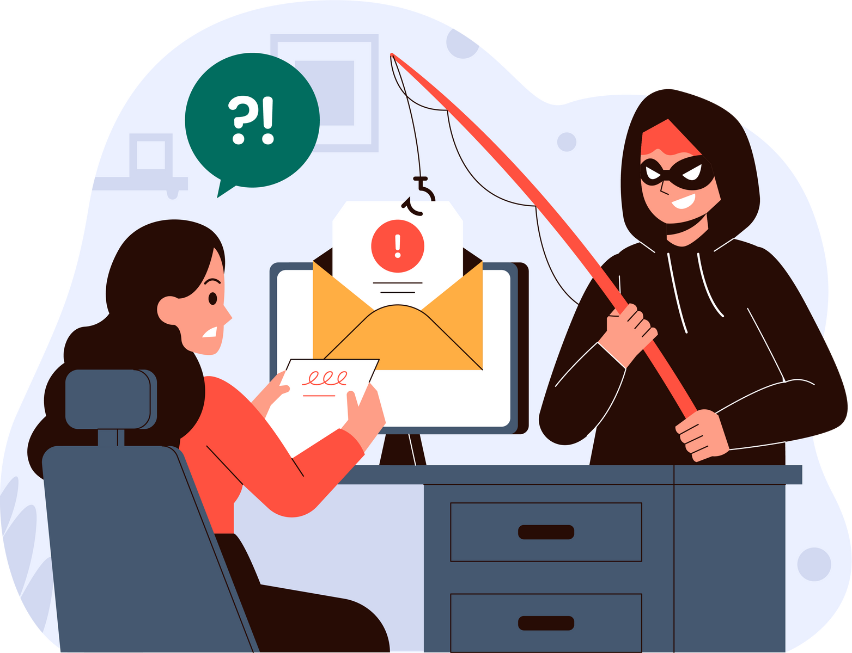
Why it Matters?
Phishing attacks are one of the most common cybersecurity threats today.
It is a widespread problem across every industry because this type of scam is extremely easy to pull off.
These attacks target individuals and organizations to steal sensitive information like passwords, credit card numbers, and personal data.
Being aware and educated is the first step in protecting yourself and your organization from these threats.

Slide 4
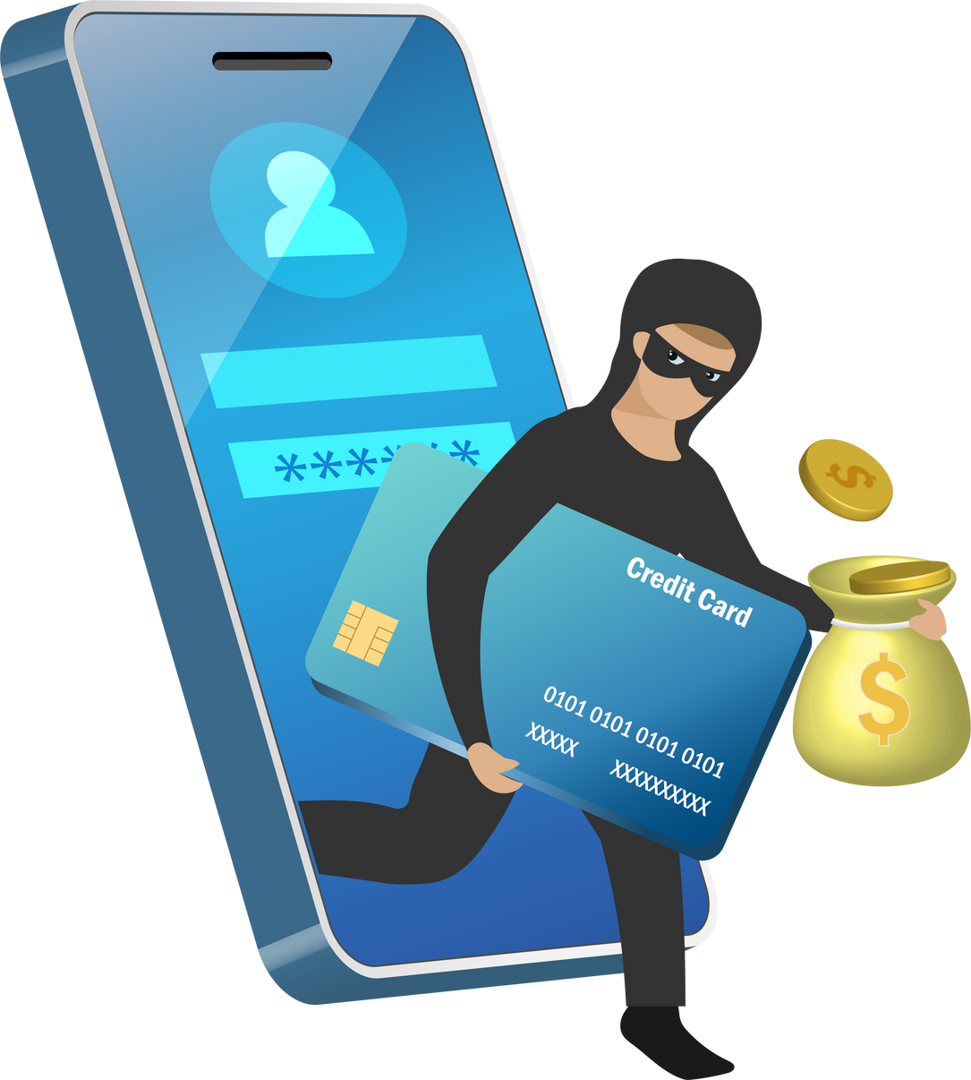
What is Phishing?
Let us Understand Phishing:
Phishing is a social engineering cyberthreat where scammers impersonate a trustworthy source and trick you into revealing sensitive data like passwords, credit card numbers, or personally identifiable information.
Phishing attacks often begin with scammers sending a malicious link or attachment via email, possibly triggering a malware download.
You may receive a phishing call that comes from a phisher pretending to offer customer service or tech support.

Slide 5


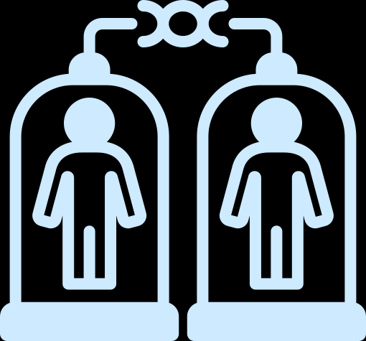


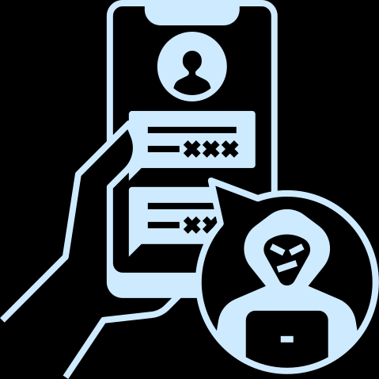
Types of Phishing Attacks
Spear Phishing
Smishing
Targeted attacks on specific individuals or organizations.
Phishing via SMS (text messages) and voice calls.
Email Phishing
Clone Phishing
Fake emails that appear to be from trusted sources.
An almost identical copy of a legitimate email with malicious links or attachments.

Slide 6
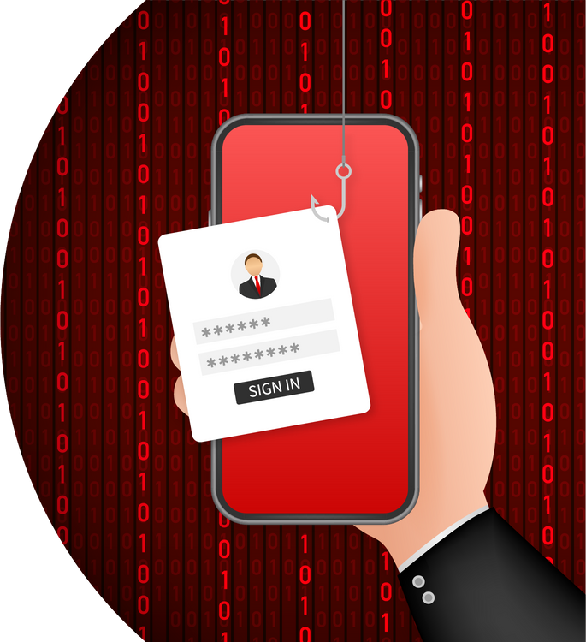
How to Spot a Phishing Email?
Let's Dive In!
Suspicious Sender: Check the email address carefully. Phishers often use addresses that are similar but not identical to legitimate ones.
Spelling and Grammar Mistakes: Poor language is often a sign of a phishing attempt.
Unexpected Attachments or Links: Never open attachments or click on links from unknown or unexpected sources.
Urgency and Threats: Phishers often use scare tactics to prompt immediate action.

Slide 7
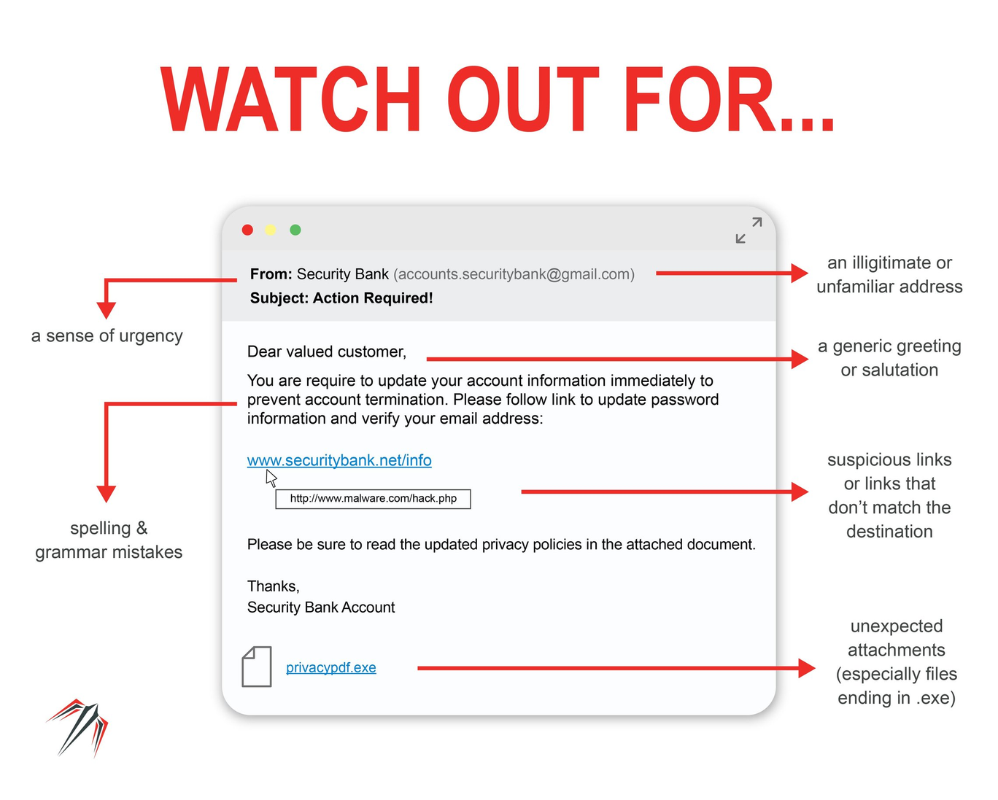
SAMPLE OF PHISHING EMAIL

Slide 8

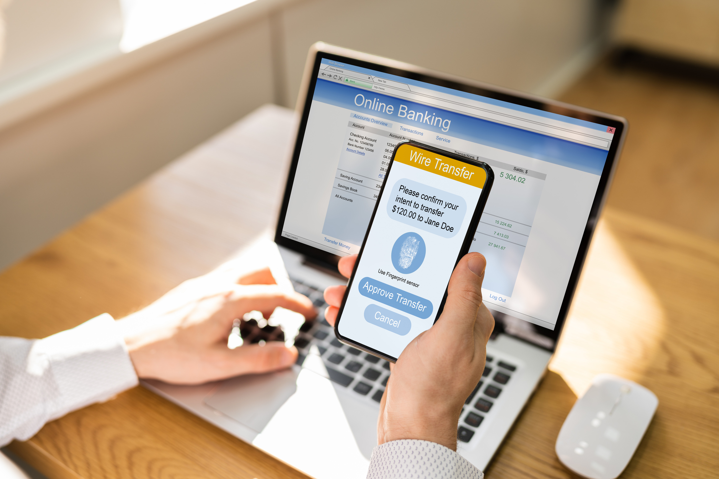

How To Avoid Phishing Traps?
Think Before You Click: Always hover over links to see the actual URL before clicking.
Enable Multi-Factor Authentication (MFA): Adds an extra layer of security to your accounts.
Keep Software Updated: Regular updates can protect against known vulnerabilities.

Slide 9


Final Tips and Best Practices
Educate Yourself and Others: Regularly review phishing awareness materials and share knowledge with colleagues.
Stay Informed: Keep up with the latest phishing trends and techniques.
Create a Culture of Security: Encourage a security-conscious environment at work.

Slide 10
THANK YOU
Protect Yourself from Online Threats

